Slide 1

“Have you ever owned something valuable that just sat there collecting dust, while someone else desperately needed it?”
Why let your tools rust or skills go unused when someone nearby needs them right now?
Let’s create a platform where sharing builds value — both economic and social.”
Together, we’re not just building an app. We’re building a community of meaningful exchange.

Slide 2
Why let your tools rust or skills go unused when someone nearby needs them right now?
Let’s create a platform where sharing builds value — both economic and social.”
Together, we’re not just building an app. We’re building a community of meaningful exchange.

Slide 3
RentoShare: Earn or Help Through Sharing
A unified platform where anyone can rent or give away their unused services or products like tractors, computers, tools, or even skills — securely and fairly.

Slide 4

Project
OVERVIEW
Problems
RentoShare: Earn or Help Through Sharing
People own underutilized assets that just rust away.
Others struggle to access affordable services/tools.
No central trusted platform exists to securely and flexibly share services or items.
Difficulty finding credible service vendors or needy users.
A unified platform where anyone can rent or give away their unused services or products like tractors, computers, tools, or even skills — securely and fairly.

Slide 5
1
3
4
2
Project
Rent a product
Donate items
Buy services
Sell your service
OVERVIEW
Rent your products to others and earn extra money
Add your unused items for someone who really needs it.
You are in need of product or service carry on use us
Have a useful skills ?
use it to earn money
Problems
People own underutilized assets that just rust away.
Others struggle to access affordable services/tools.
No central trusted platform exists to securely and flexibly share services or items.
Difficulty finding credible service vendors or needy users.

Slide 6
1
3
4
2
Rent a product
Donate items
Buy services
Sell your service
Rent your products to others and earn extra money
Add your unused items for someone who really needs it.
You are in need of product or service carry on use us
Have a useful skills ?
use it to earn money

Slide 7

How we solve the scamming ?
1
3
4
2
Challenges of our project
Scams / Fake listings
Wrong/defective product on delivery
Lack of trust
Seller bias in giveaways
Payment frauds
Rent a product
Donate items
Buy services
Sell your service
Rent your products to others and earn extra money
Add your unused items for someone who really needs it.
You are in need of product or service carry on use us
Have a useful skills ?
use it to earn money

Slide 8
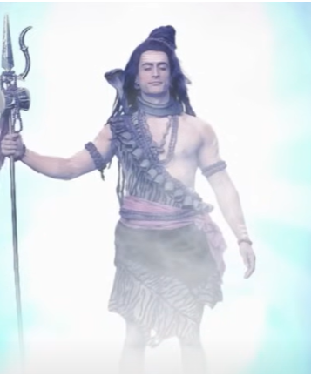
IDK !
How we solve the scamming ?
Challenges of our project
Scams / Fake listings
Wrong/defective product on delivery
Lack of trust
Seller bias in giveaways
Payment frauds

Slide 9
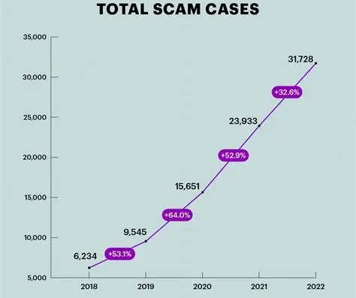
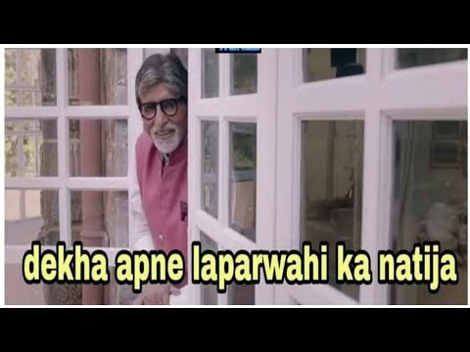
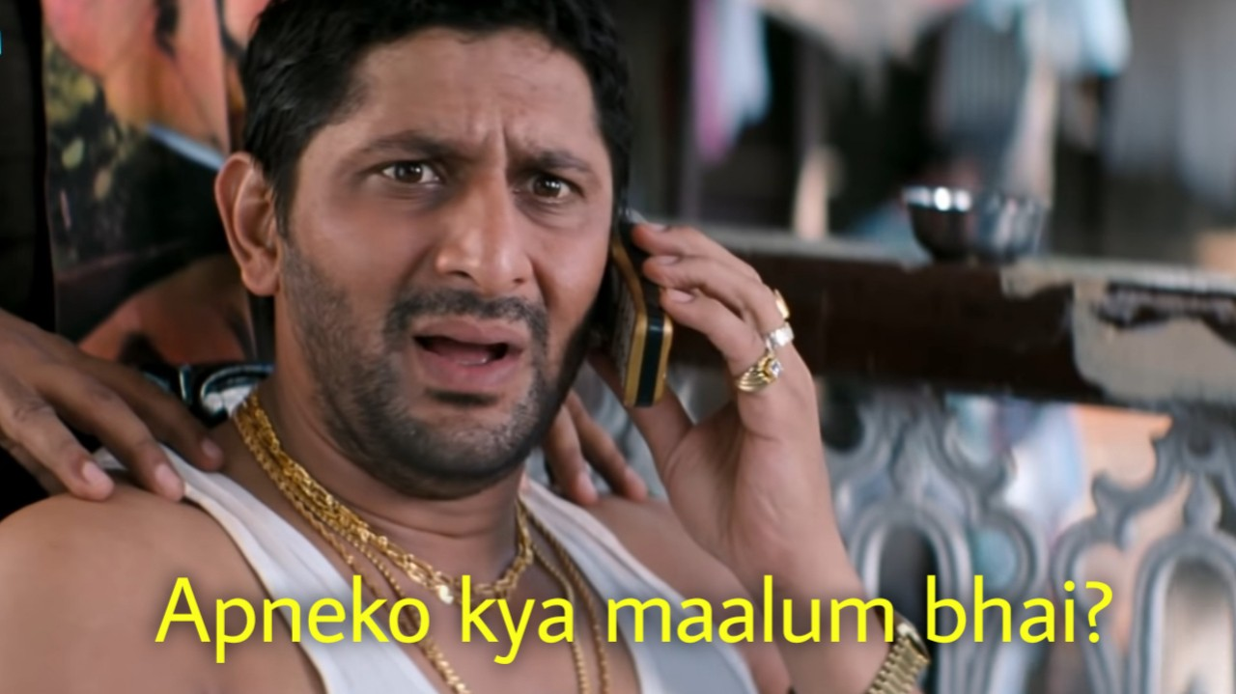
GOD Knows !
IDK !

Slide 10
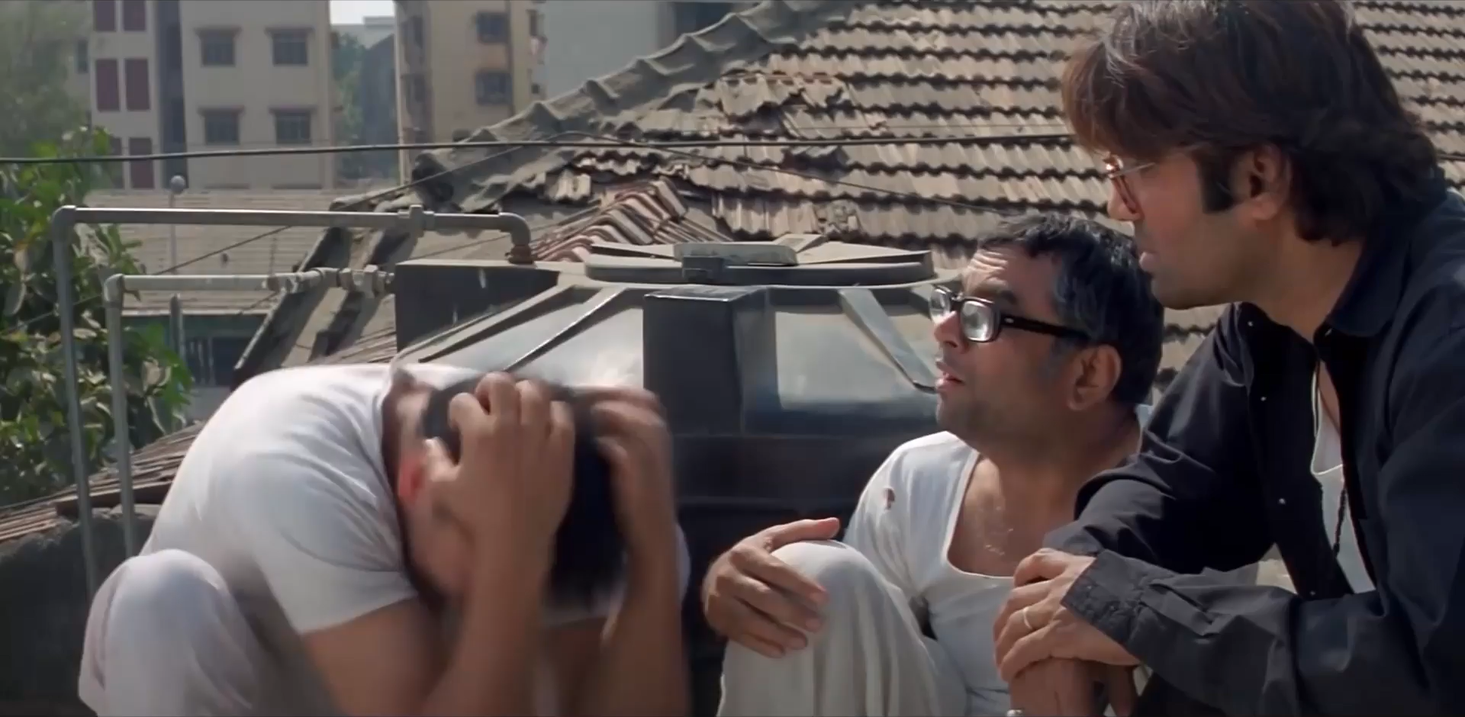
IDK !
Paisa Hi Paisa Hoga

Slide 11

Monetization Plan
(How Platform Earns)
Platform fee:
1% fee from vendor
0.5% from consumer
Total: 1.5% per successful transaction
Featured Listings: Vendors can pay to show their listings on top
Ad Revenue: Ads will be shown smartly in-app and on the site
Paisa Hi Paisa Hoga

Slide 12

Survival & Long-Term Vision
Platform is user-driven: No need to manage products or services ourselves
Scalable: Focus only on maintaining servers and improving features
Free/cheap hosting now; later move to better cloud infrastructure as we grow

Slide 13
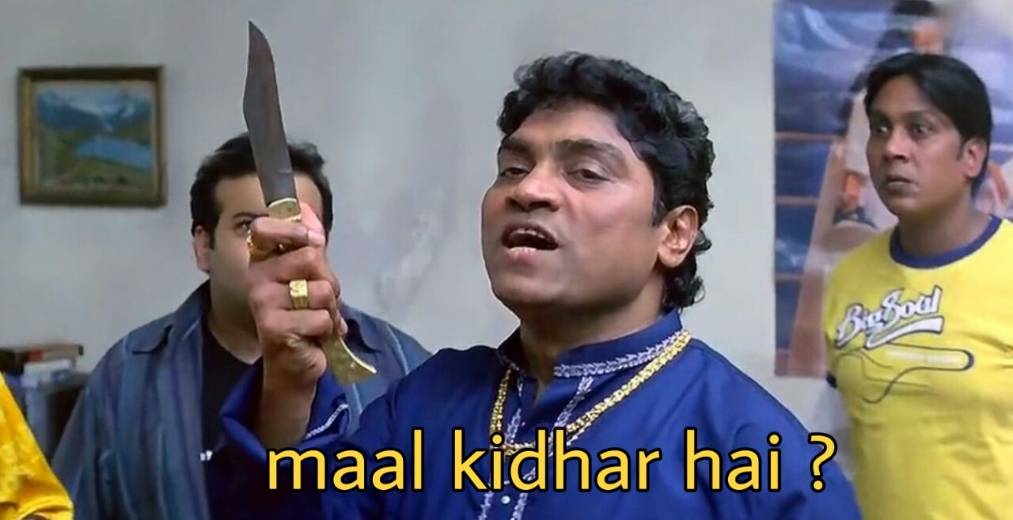
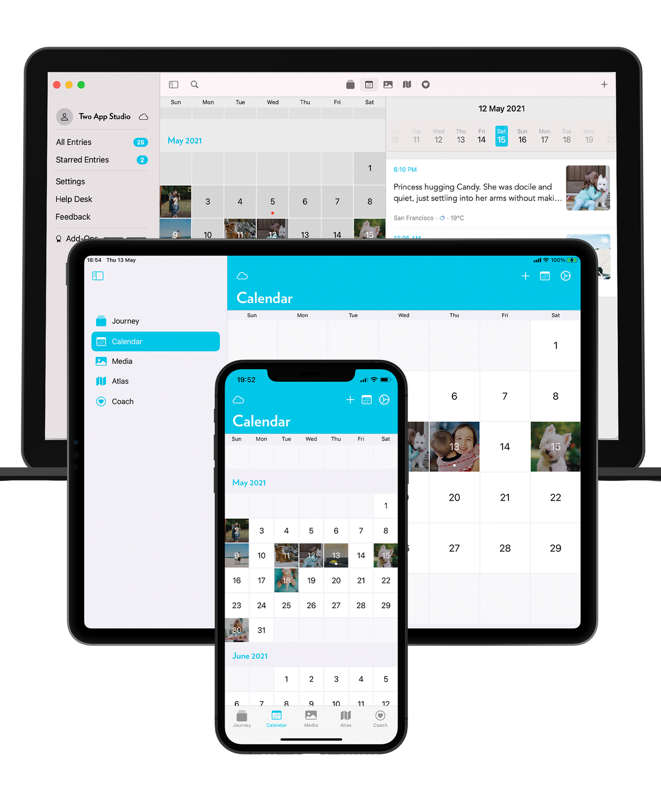


Deliverables
🖥 Desktop App (Windows, mac, Linux)
📱 Android App
📱 iOS App
🛠 PWA (Progressive Web App) for browser

Slide 14


Technology Stack
Flutter (Android, iOS, Web)
Django (REST API)
PostgreSQL (Database)
Stripe / eSewa / Khalti
Amazon S3 / Django Media (App CDN)
JWT or OAuth2 ( Authentication)

Slide 15
Future plans
AI-based trust scoring system
Map-based discovery of local services
Voice search and image-based listings
Mobile app with offline mode
Partner with local governments or NGOs to distribute free goods/services
Open source SDK/API for integrations

Slide 16

Thank you

